Slide 1
Resolve homophone using a hierarchical LSTM
By ZhichengLiu

Slide 2
Problems: Chinese homophone
Punctuation imprecisely hampered speech recognition
我想吃五仁月饼/我想吃五人约饼
我 想 吃 五仁月饼/我 想 吃 五人约 饼
Homophone cause many problems
Speech recognition can’t resolve homophone
Segmentation error rate highly increase
Error accumulates as components of model boost

Slide 3
Why can’t resolve homophone?
A sentence segmentation error up to 95% once a homophone exists
我 想 吃 五仁月饼/我 想 吃 五人约 饼
SR have some methods to resist this problems, but ………

Slide 4
Get right word in memory
Human can find the error in sentence quickly
Regular words, phrase
No need for segmentation
Segmentation is really necessary ?
Homophone has the same Pinyin.

Slide 5
Our Contribution
A hierarchical LSTM
word embedding generation
Finding most fitting word

Slide 6
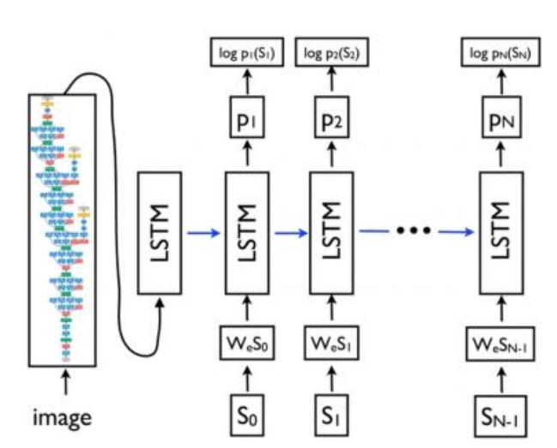
A hierarchical LSTM(Encoder)
通过单字的拼音输入LSTM作为单字的词向量
以上述词向量作为Sequence labeling的输入对单字进行labeling操作
字向量采用fasttext与LSTM join操作组合而成
整句输出之后选择最合适的替代词
pinyin

Slide 7
Word embedding generation
随机初始化26个字母以及0-9个数字的fixed length vector
所有字母的char embedding通过网络训练
将char embedding通过LSTM之后生成的memory与fasttext生成的字向量join形成该字的字向量输入LSTM进行单字的labeling

Slide 8
Finding substitution
通过选择对单字词向量最接近的n个词中是否存在可替代的单字使得整句话labeling loss减小
采用lazy selection策略, 设置超参数threshold, 对于loss减少小于threshold的字不予替换

Slide 9
Evaluation
 | Bi-LSTM | Bi-LSTM-CRF | CNN-LSTM | Ours
no homophone | 95.70% | 98.30% | 96.42% | 96.70%
all homophone | 39.10% | 55.72% | 51.54% | 79.35%
with homophone | 75.34% | 83.42% | 80.69% | 92.53%

Slide 10
Future Work
Substitution selection 能否加入网络做成end-to-end
Threshold超参数的选择通过网络训练得到
lazy reaction in 生僻字

